Slide 1




Presenter: Yetong Cao Yetong Cao*, Qian Zhang†, Fan Li*, Song Yang*, Yu Wang‡ *School of Computer Science and Technology, Beijing Institute of Technology, China †School of Software and BNRist, Tsinghua University, China ‡Department of Computer and Information Sciences, Temple University, USA
PPGPass: Nonintrusive and Secure Mobile Two-Factor Authentication via Wearables

Slide 2

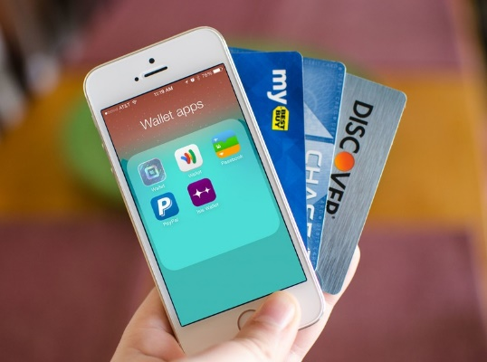



Motivation
Mobile devices tend to amass a vast amount of information
2FA can improve system security and enhance user privacy-preserving.
Personal Information
Financial Information
Secret Documents
increase the difficulty of attack
neutralize the risks when one factor is compromised

Slide 3
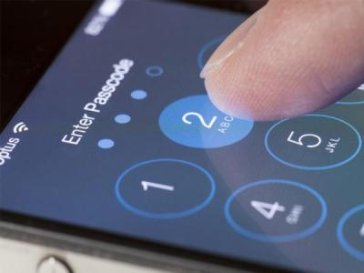
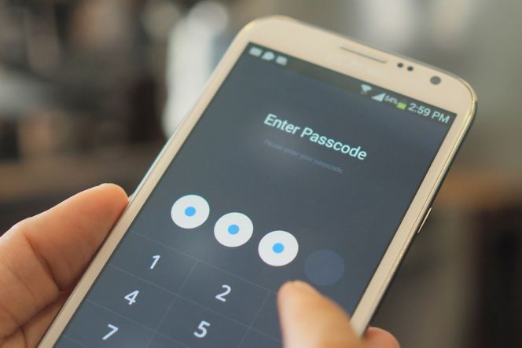
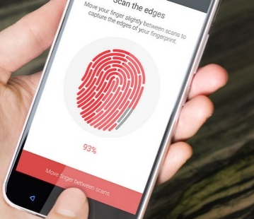
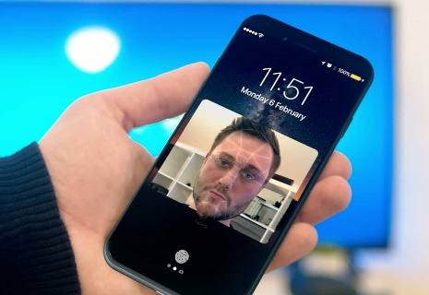

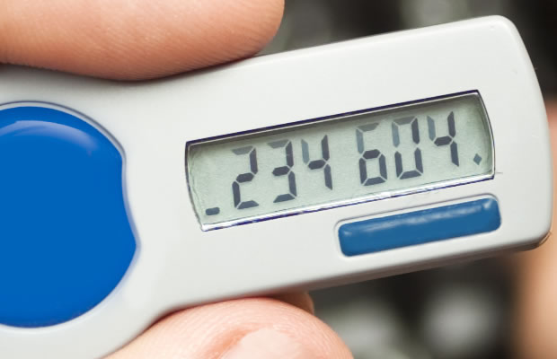
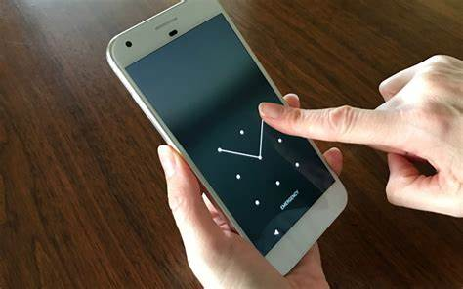
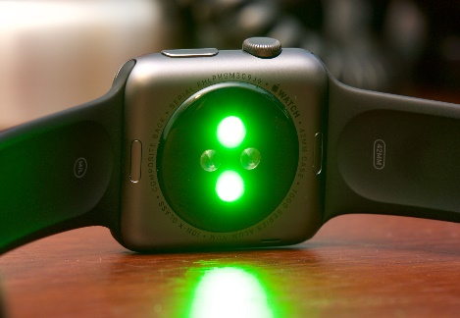
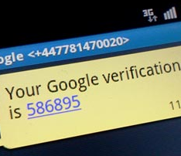
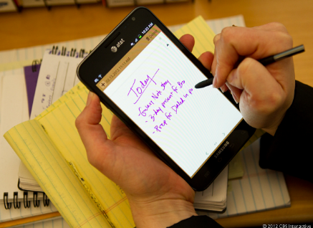
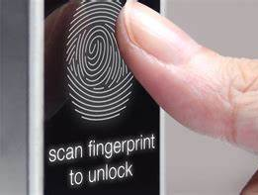

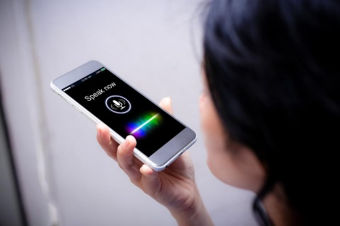
Exiting Approaches
2FA requires the user to have 2 out of 3 types of credentials.
Something You Know
Major drawbacks: extra user involvement, security issues.
Something You Have
Something You Are

Slide 4
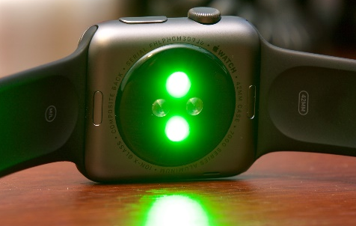
Goals
Nonintrusive authentication
Do not require extra involvement
High accuracy authentication
Identify authorized users and malicious attackers
Secure authentication when biometrics are compromised
Allow users to re-register alternative credentials
Photoplethysmography (PPG) : widely developed in wrist-worn devices, provide heartbeat signal.

Slide 5

Basic Idea
New Templates
Motion Artifacts!

Slide 6
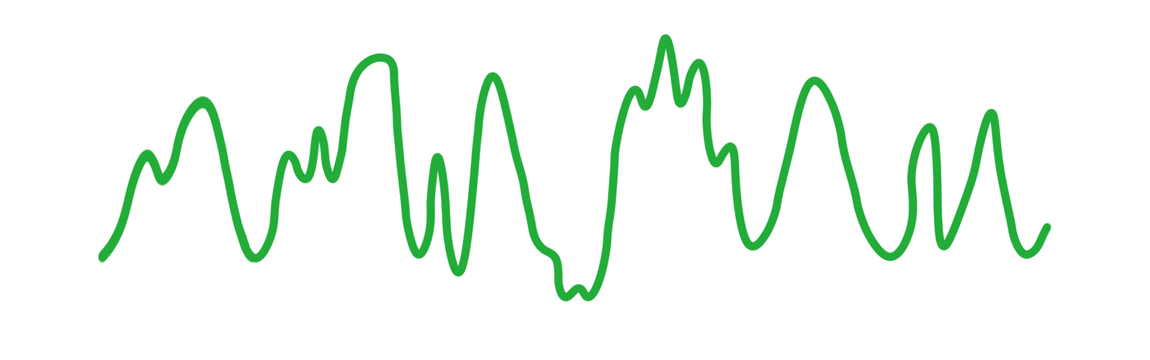

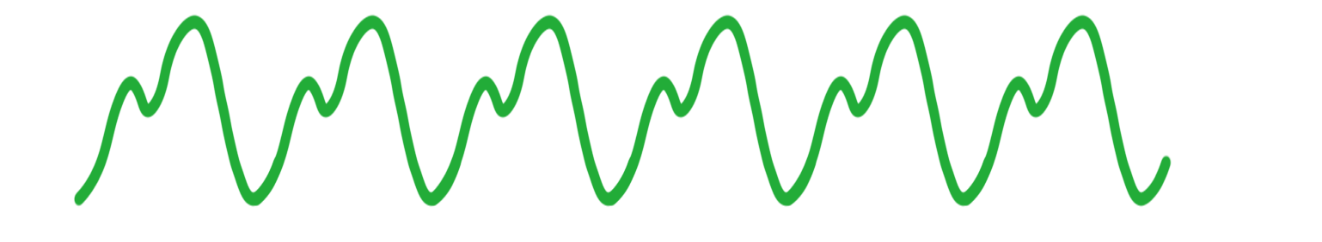

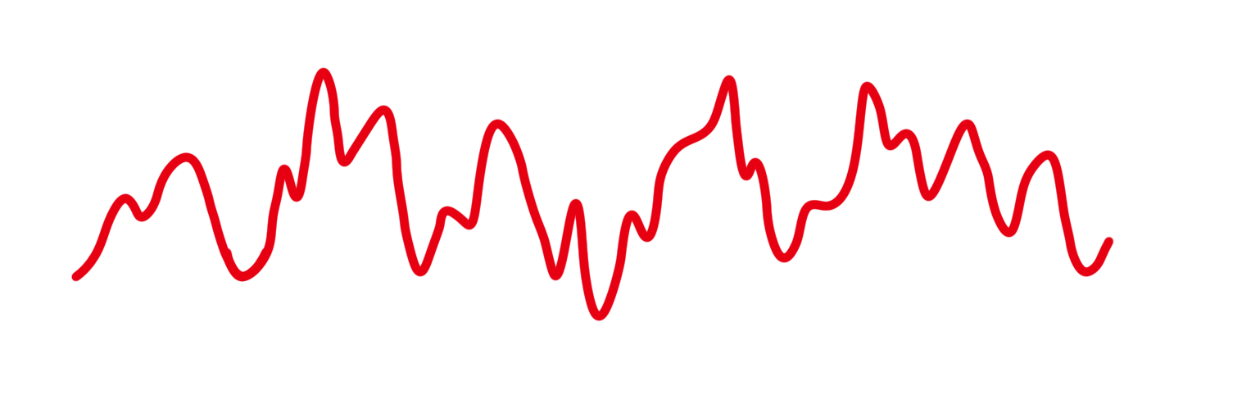

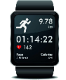
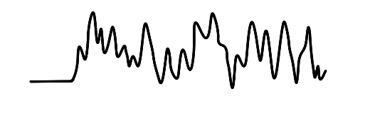
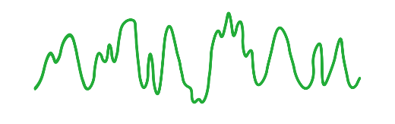
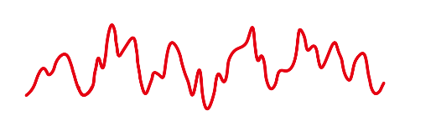
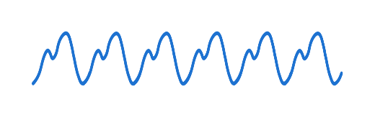
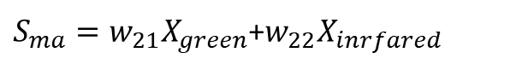
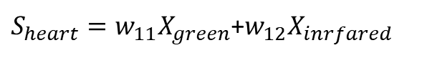
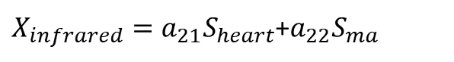
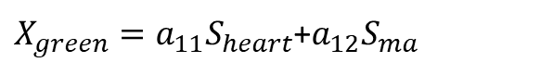
Basic Idea
Enter Passcode
1
2
3
4
5
6
Green
7
8
9
Infrared
$X_{green}=a_{11}S_{heart}$+$a_{12}S_{ma}$
$S_{heart}=w_{11}X_{green}$+$w_{12}X_{inrfared}$
$X_{infrared}=a_{21}S_{heart}$+$a_{22}S_{ma}$
$S_{ma}=w_{21}X_{green}$+$w_{22}X_{inrfared}$

Slide 7
Overview
PPG Signal Preprocessing
C1: How to separate clean heartbeats from PPG signals contaminated by MAs?
Bandpass Filtering
Data
Two
-
S
Acquiring
tage MAs
Removal
Signal Separation
Adaptive Filtering
Individual Feature Characterizing
C2: How to characterize intrinsic and consistent features from PPG signals?
Cardiac Cycle Segmentation
Multiple Cardiac Cycle
Single
Cardiac Cycle
s
Data Reshaping
Geometric
Feature Extraction
Cancelable Feature Generating
C3: How to generate alternative credentials when biometrics are compromised?
User
Feature
Transformation
Templates
Feature Shuffling
Cancelable Feature
Template
s
Classification
User
Attacker

Slide 8

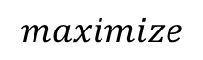
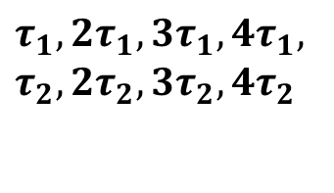
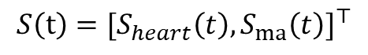
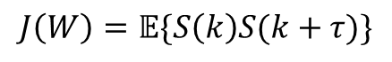
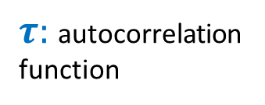
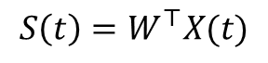
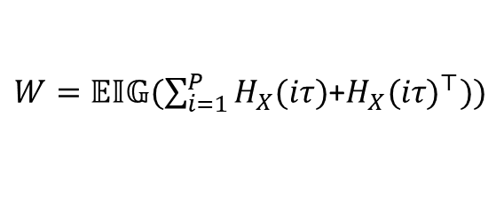
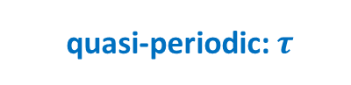
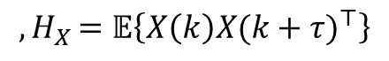
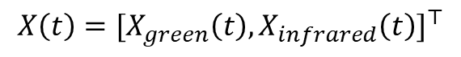

PPG Signal Preprocessing
Data Filtering
MAs
Human heartbeat
( )
Hz
0.25-10Hz Butterworth ﬁlter
0
0.1
0.25 10
0.5 4
MAs Removal: stage 1
estimate heartbeat signals and MAs using a modified semi-blind source separation algorithm
$$X\left(t\right)=[X_{green}\left(t\right),X_{infrared}\left(t\right)]^{⊤}$$
$$S\left(t\right)=[S_{heart}\left(t\right),S_{ma}\left(t\right)]^{⊤}$$
quasi-periodic:$τ$
non-periodic
$τ:$autocorrelation function
$$S\left(t\right)=W^{⊤}X(t)$$
lowest skewness
&kurtosis
$$maximize$$
$$J\left(W\right)=𝔼\{S\left(k\right)S(k+τ)\}$$
$τ_{1},2τ_{1},3τ_{1},4τ_{1},$ $τ_{2},2τ_{2},3τ_{2},4τ_{2}$
$$W=𝔼𝕀𝔾(H_{X}+{H_{X}}^{⊤})$$
$${,H}_{X}=𝔼\left\{X\left(k\right)X(k+τ)^{⊤}\right\}$$
$W=𝔼𝕀𝔾(\sum_{i=1}^{P}{H_{X}(iτ})$+$H_{X}(iτ)^{⊤}))$
MAs Removal: stage 2
Heartbeat signals and MAs are not ideally linear mixed
apply adaptive step-size least mean squares (AS-LMS) ﬁlter

Slide 9
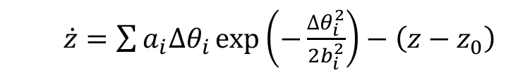
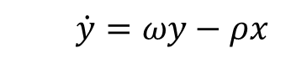

Individual Feature Characterizing
use the 1st and 2nd derivative to find local minimums and maximums
Segmentation
Data Reshaping
Signal lengths and amplitudes between cycles present nonstationary over time
transform signals from the time domain $\left(x,y\right)$ to angle domain$\left(\dot{x},\dot{y},\dot{z}\right)$
$$\dot{x}=ωx−ρy$$
$$\dot{y}=ωy−ρx$$
$\dot{z}=\sum{a_{i}∆θ_{i}\exp\left(−\frac{∆θ_{i}^{2}}{2b_{i}^{2}}\right)−\left(z−z_{0}\right)}$
Fiducial Points
Feature Extraction
extract 40 features from single cardiac cycle and multiple cardiac cycles

Slide 10
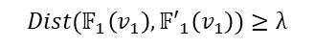

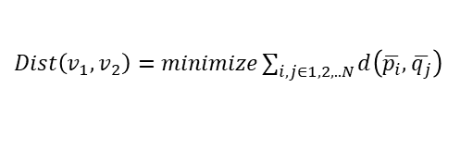
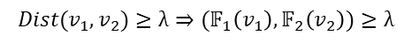
Cancelable Feature Generating
Security Issues
Application Cross-matching
Noncancelable
Privacy Leakage
Feature Transformation
Repeatable
Non-invertible
Features of user 2
Features of the same user
Features of user 1
Transformed
Transformed
Transformed
Transformed
by
F
by
by
a new function
by the old function
1
F
2
Large
Large
Dissimilarity
Dissimilarity
select the function that has the maximum $Dist\left(∗\right)$ between feature vectors, shufﬂe the order of the features
$$Dist(𝔽_{1}\left(v_{1}\right),{𝔽′}_{1}\left(v_{1}\right))≥λ$$
$Dist\left(v_{1},v_{2}\right)=minimize\sum_{i,j∈1,2,..N}{d\left(\overline{p_{i}},\overline{q_{j}}\right)}$
$$Dist(v_{1},v_{2})≥λ⇒(𝔽_{1}\left(v_{1}\right),𝔽_{2}\left(v_{2}\right))≥λ$$

Slide 11
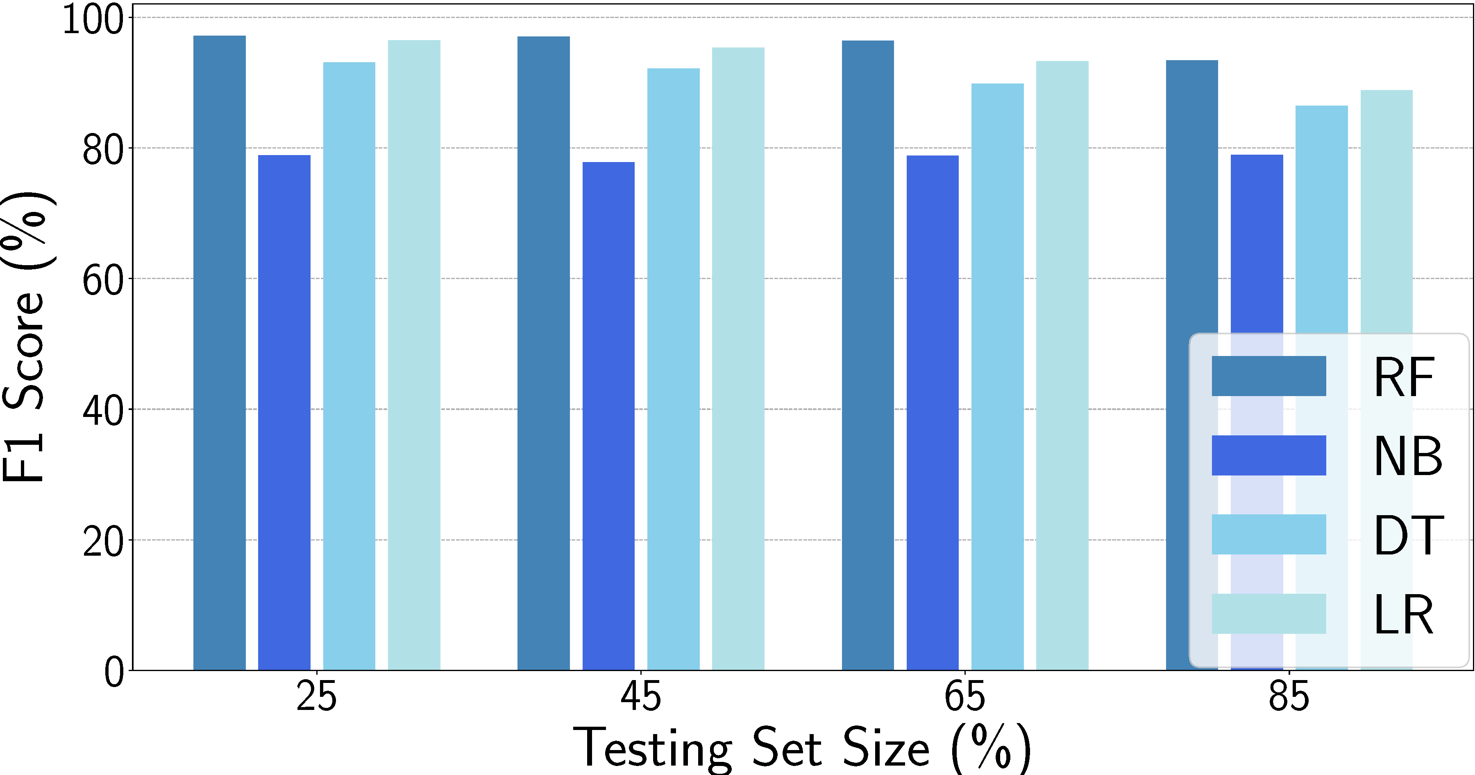

Classification
Random Forest (RF)
Naive Bayes (NB)
Decision Trees (DT)
Logistic Regression (LR)
Random Forest

Slide 12

Experiment
Setup
prototype
400hz
Recruitment
7participants
3 testing scenarios：
passwords inputs
patterns inputs
signatures writing
3,780 samples
Ground Truth
AD8232 ECG
Prototype
Three Testing Scenarios

Slide 13
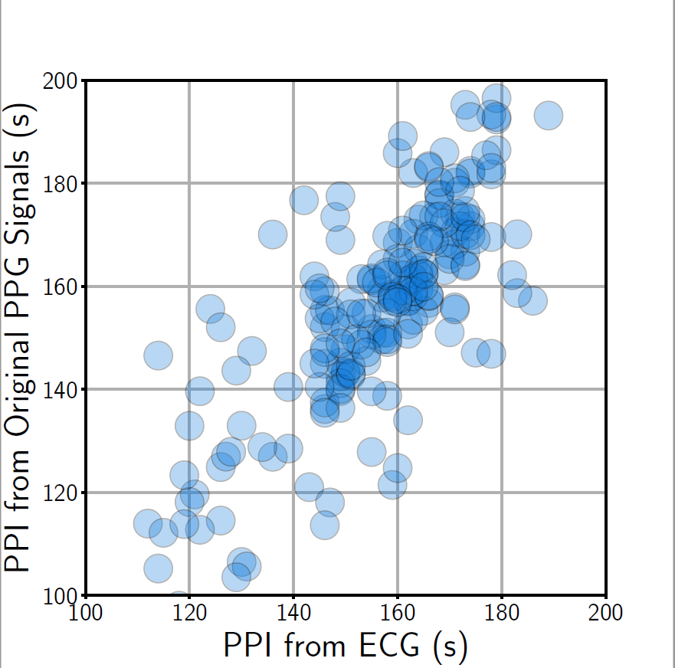
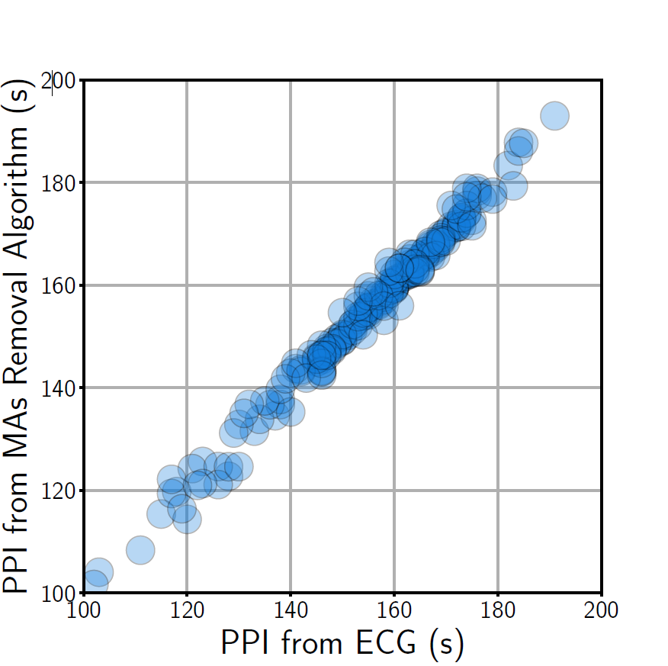
Efﬁciency of MAs Removal Algorithm
PPI from original PPG signals
PPI from MAs removal
After removing MAs, all points are clustered around the diagonal.

Slide 14
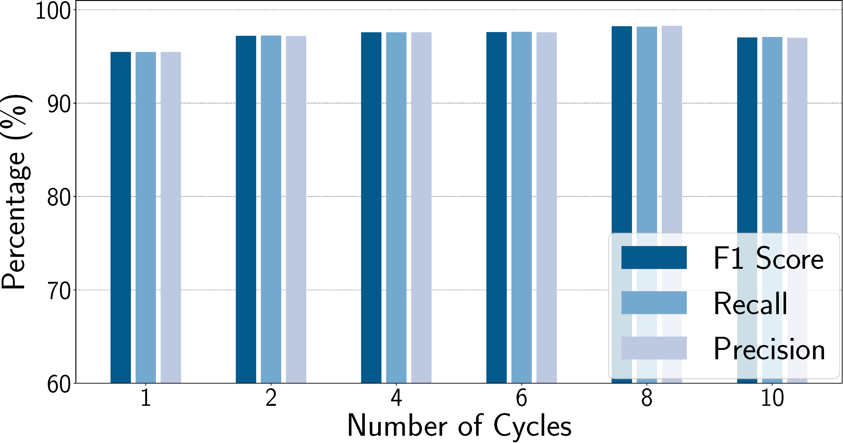
Overall Performance: passwords inputs
The average F1 score is 97.18%.

Slide 15
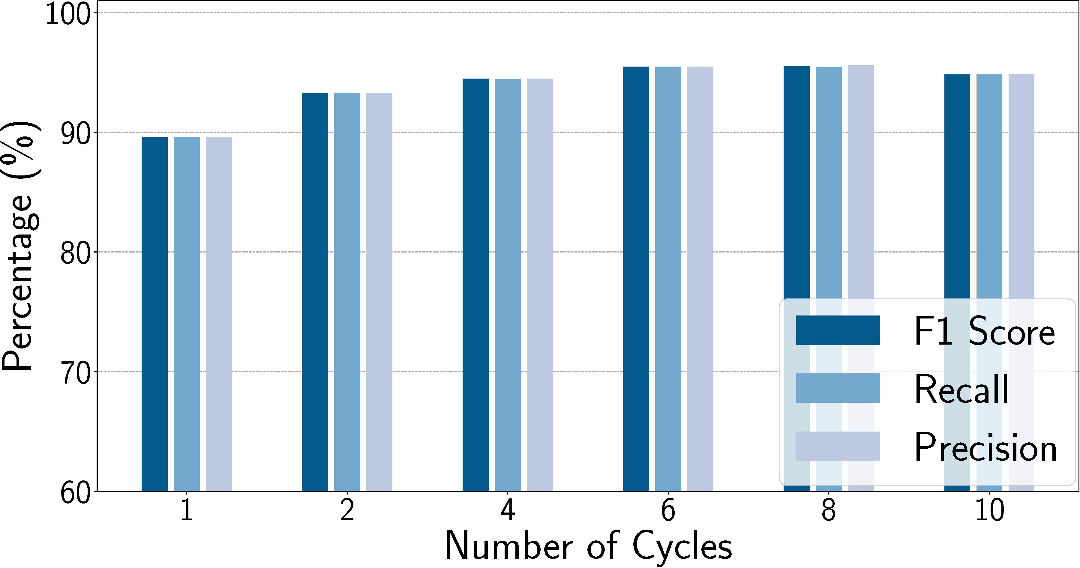
Overall Performance: patterns inputs
The average F1 score is 93.87%.

Slide 16
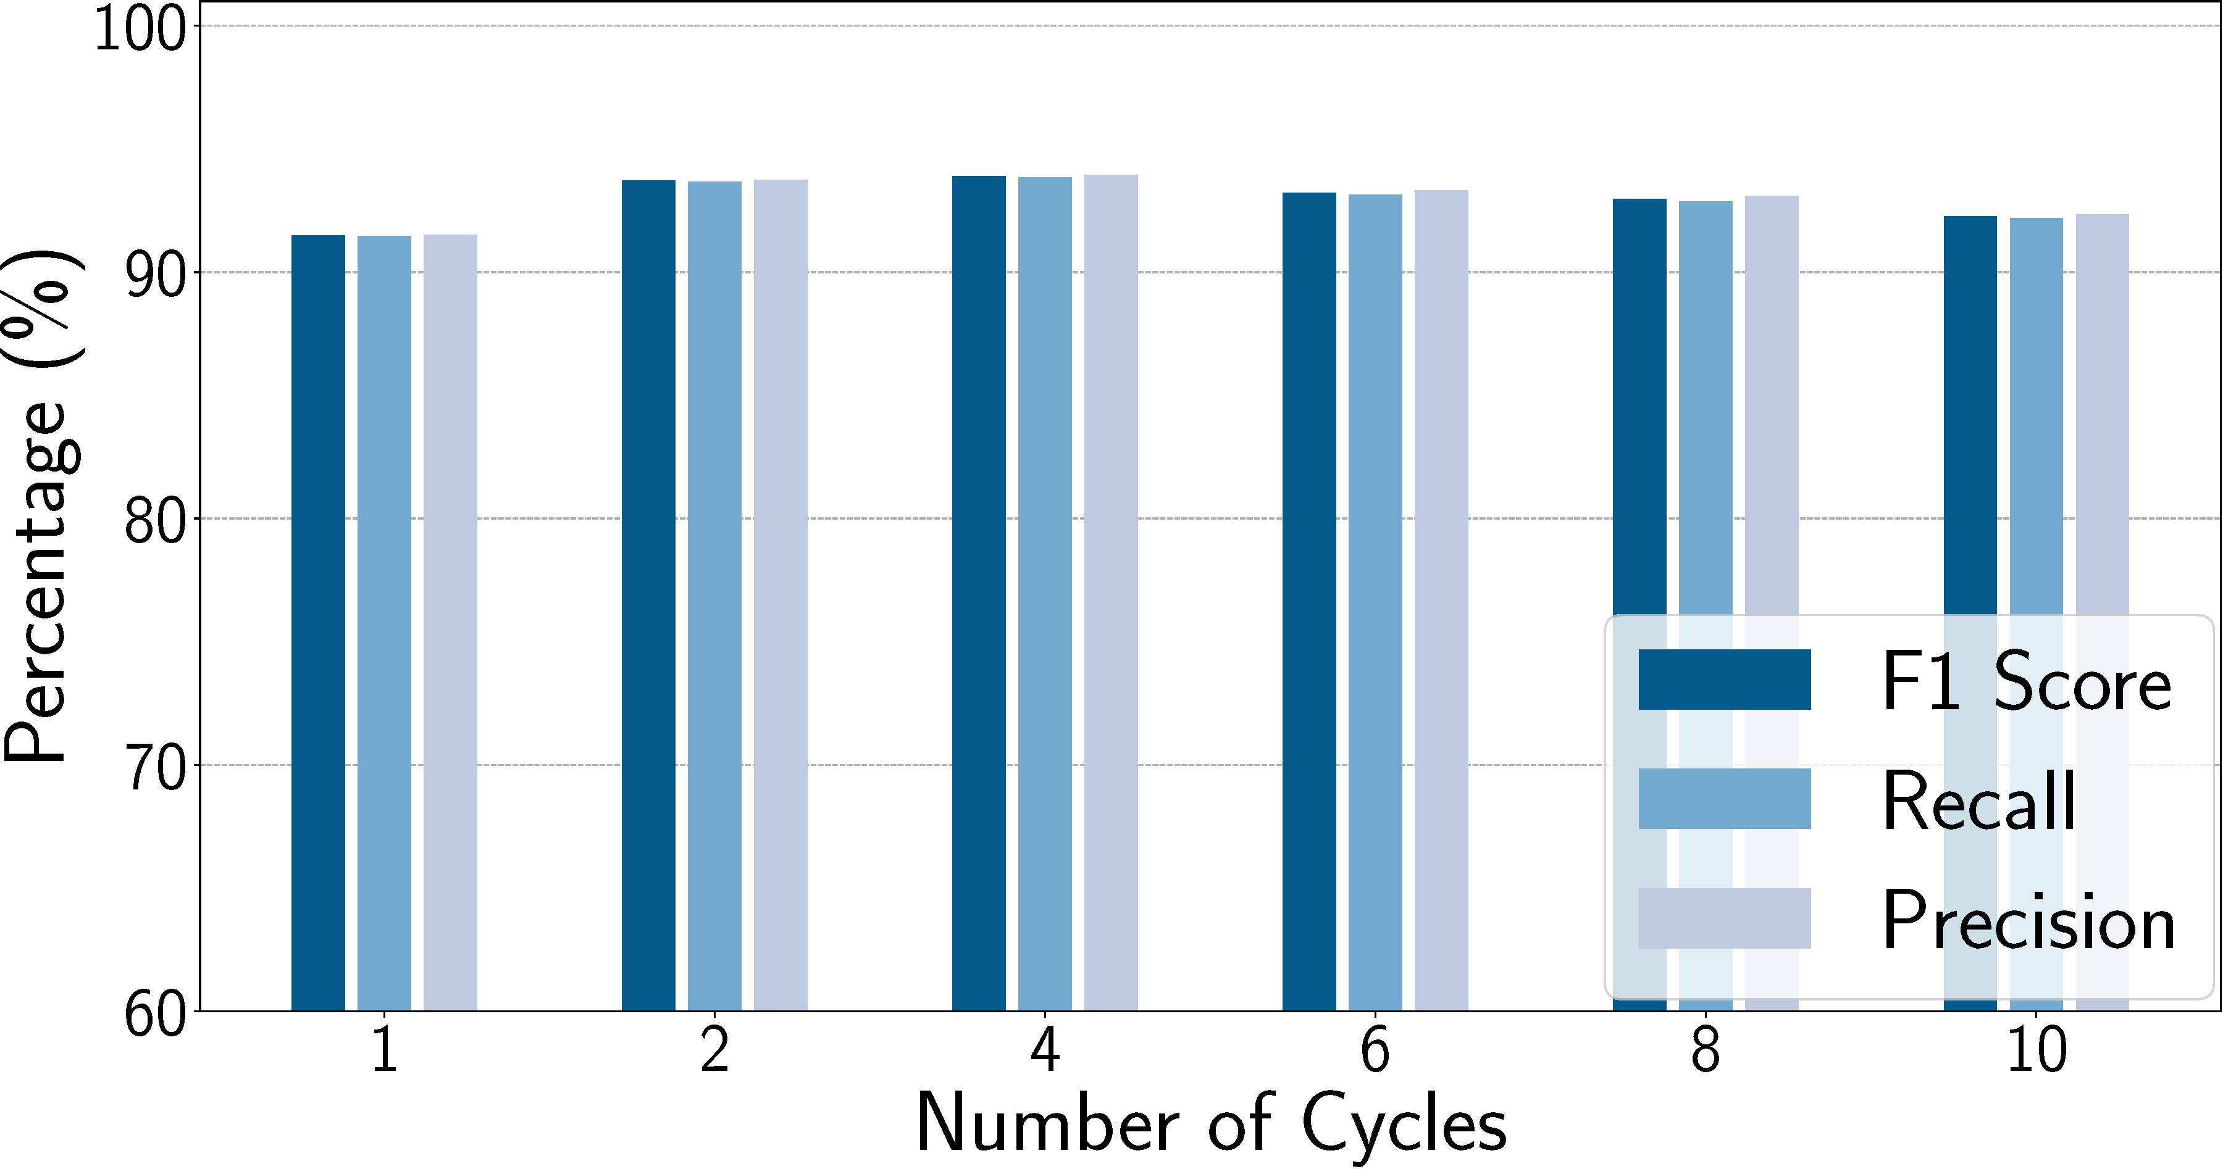
Overall Performance: signatures writing
4 cardiac cycles achieves the best performance for three conditions.
The average F1 score, recall, and precision for 4 cycles of the three conditions are all above 95%.
The average F1 score is 92.93%.

Slide 17
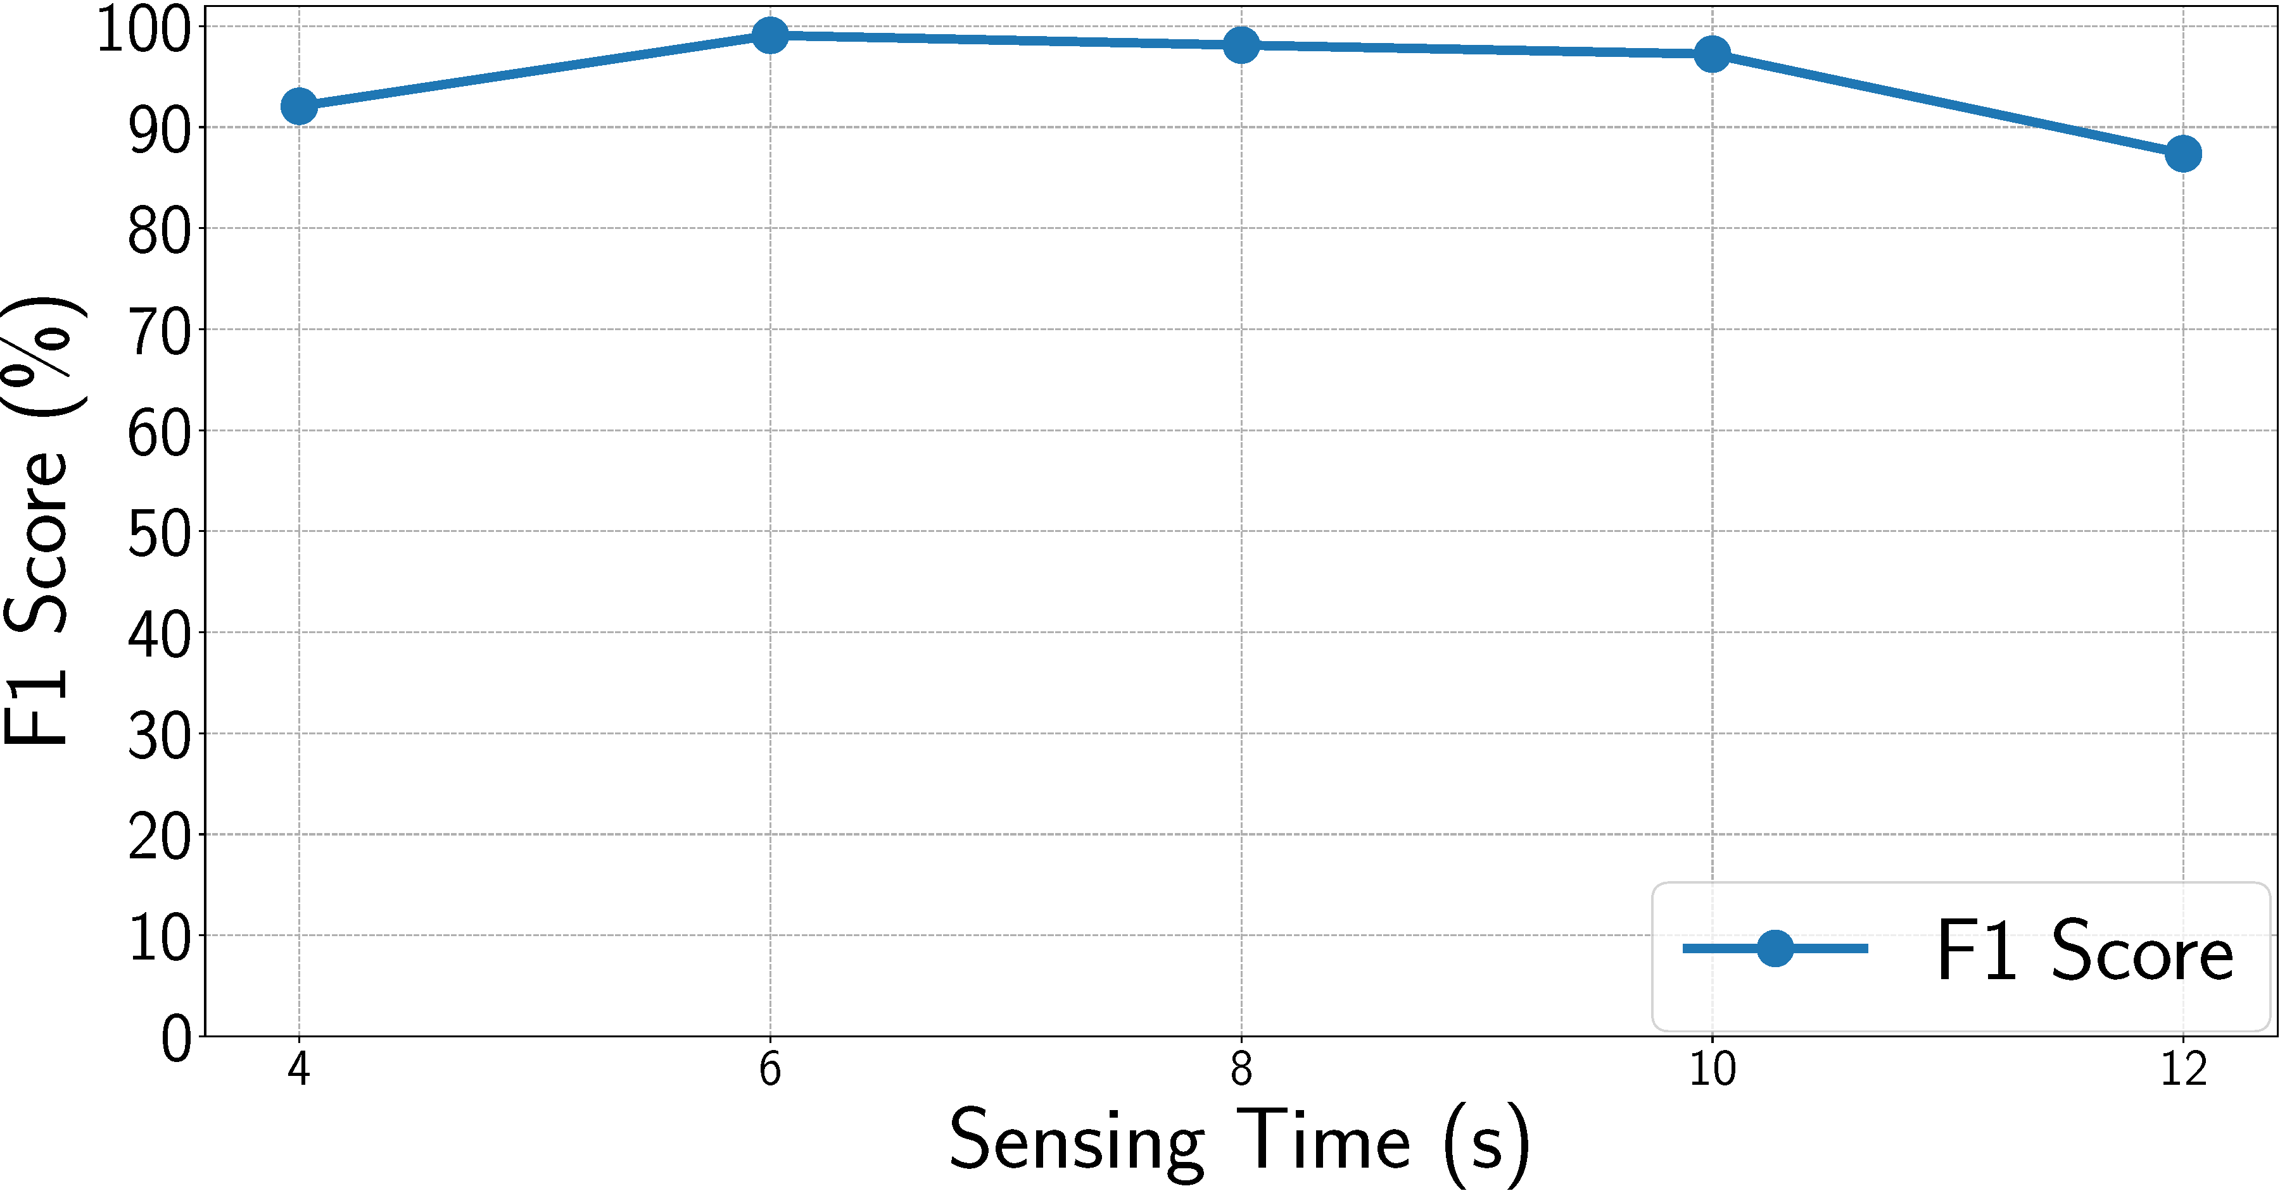
Time Duration
F1 scores are 92.1%, 99.1%, 98.1%, 97.2%, and 87.4%, respectively.
the average system response time is 1.8s.

Slide 18
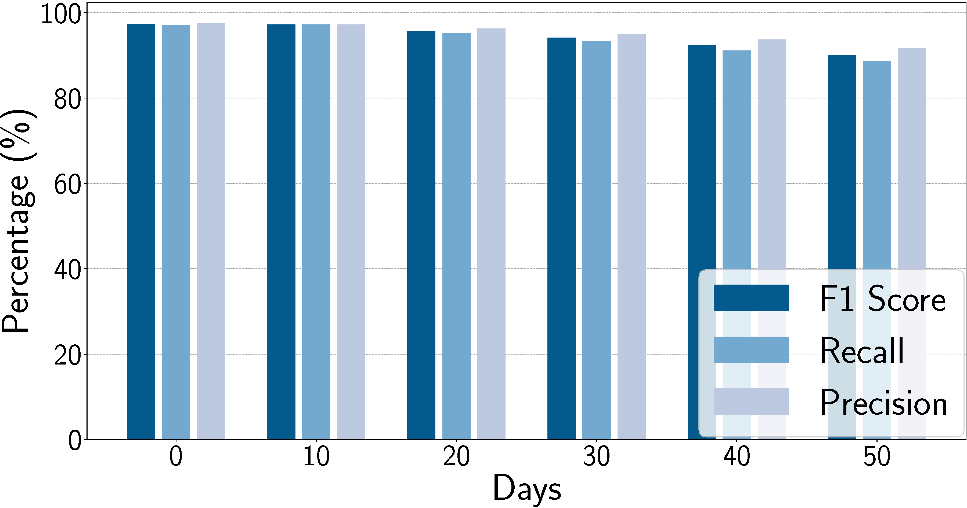
Long-Term Study
F1 score achieve 97.3%, 97.2%, 95.7%, 94.2%, 92.4%, and 90.1%, respectively.

Slide 19
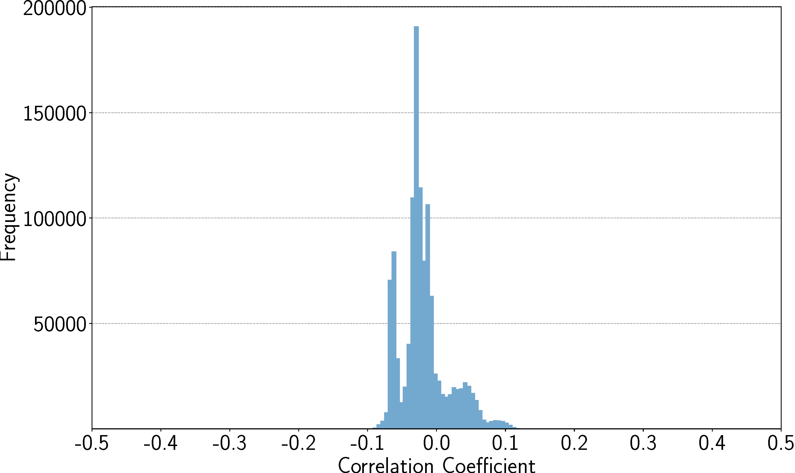
Cancelability
Features | F1 score | Recall | Precision
Previous Features | 94.6% | 94.7% | 94.6%
New Features | 96.1% | 93.7% | 98.6%
The results center at zero, mainly ranging between [−0.1,0.1].

Slide 20
Conclusion
Propose PPGPass, the novel nonintrusive and secure mobile two-factor authentication system, which leverages PPG sensors in wrist-worn devices
Present a mobile 2FA framework to separate clean heartbeat signals and generate cancelable features without requiring extra user involvement
Implement a wrist-worn prototype
Demonstrate the robustness and sustainability of the system

Slide 21

Thanks!
Thanks!
Thanks!
IEEE International Conference on Computer Communications
6-9 July 2020 // Virtual Conference

